Slide 1
Students’ sleep and academic performance
Ângela M. Katsuyama
Post-doc, Horacio de la Iglesia’s lab
Data Science Incubator, Fall 2014

Slide 2


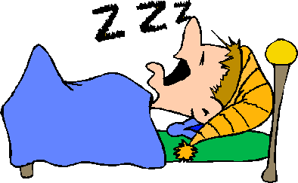
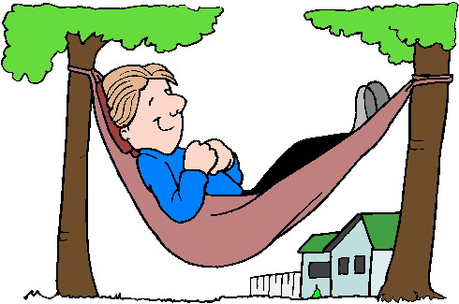
Hypothesis: Poor academic performance in college students correlates with poor sleep behaviors
Post-Tone
Course: Biological Clocks and Rhythms, Spring 2014
72 students, seniors
Data recorded over: 6 days, including 1 weekend.
Purposes: Research, teaching and public health goals.
Sleep parameters:
chronotype
social jetlag
variability of sleep onset, duration, offset etc
Performance: grades (midterms, quizzes etc)
Notes:
This is also a project investigating how sleep plays are role in learning.
The advantage of this project, even though being a field study (and therefore not susceptible to intervention), is the N (Biology has 1500 students per year), the fact that we can actually record data without interference (no need to add extra performance tests) and also the uniformity (all the students are taking the same class and same exams).
The demographics of our students, diversity etc already introduces population variability to the analysis. This can be added as information later.
Chronotype: important to say that not just the chronotype (late/early) is important, but the mismatch between the chronotype with the work schedules. The same for the social jetlag. Explain how chronotype is related to social jetlag.
Gender: prediction is that sleep disturbances in women lead to worse performance (already published in the literature).

Slide 3
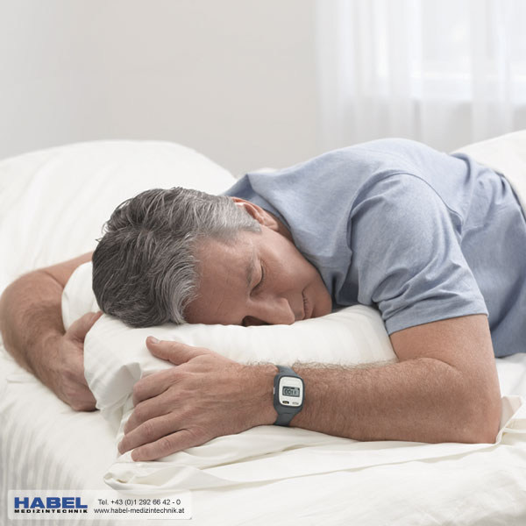

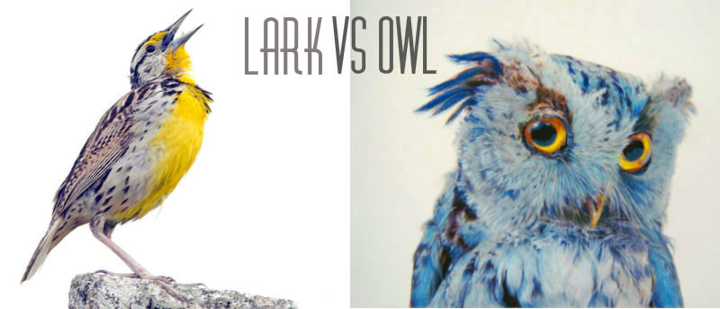


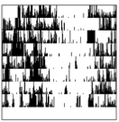
Datasets and Scientific Questions
Data from:
1)
Example:
Actiwatch
2)
Sleep Diary
3)
Chronotype
questionnaires
Correlated to:
Grades?
Gender?
Notes:
Datasets:
Sleep recordings were generated from actiwatches worn by 68 students enrolled in BIO418 course, during the Spring
2014. Other sources of data collection were: sleep diaries (filled out in online forms, self-reported), chronotype
questionnaires to assess whether the student is a ‘late’ or ‘early’ type when it comes to sleep habits, grades (generated
from Canvas after input of exams and quizzes scores).
Scientific questions:
- Are there gender differences for any of the sleep patterns and parameters analyzed?
- Are specific sleep patterns predictive of high or low academic performance?
- How does light exposure interfere with sleep patterns and, therefore, performance?
- Does day-to-day variability predict performance?
- Does workday-to-weekend day variability predict performance?
- The sleep parameters to be analyzed include but are not limited to: sleep duration, sleep onset, sleep variability
throughout week, sleep latency, social jetlag (difference between workday and weekend sleep timing), chronotype
(morning vs. evening activity preference), sleep efficiency, number of disturbances. These and other sleep
parameters can be calculated from either the wrist actimeter or diary data, to assess their predictive value in terms of
academic performance.
Potential future questions:
Does time of lab class influence performance? How does chronotype correlate with class time and performance? Are
there ethnic/sociocultural differences in sleep patterns and how do they correlate with performance? Does living on or off
campus influence sleep patterns and performance?
Technical challenges faced:
1) Our project falls within ‘Data management and automation’ category. SQL would aid our analysis capabilities for
processing large amounts of data. Currently, it takes too much time and effort just to organize data manually. We need to
integrate data coming from multiple files so it can be analyzed in a fast, simple and reliable way. Some utility tools we
envision are: Be able to get a discrete temporal window from the raw data. Compile data from wrist actimeters and diaries
automatically and use this to calculate sleep latency. Be able to identify possible outliers by applying filters to the data
(example: if it diary bedtime is later than actimeter sleep onset, discard this data point).
2) As secondary goal, in the future, we also would be interested in developing simple algorithms that students can use to
plot and visualize their own individual data. As opposed to the integration of large datasets, here we would be looking for
an intuitive and easy educational tool to be used in the classroom and integrated as part of the coursework

Slide 4
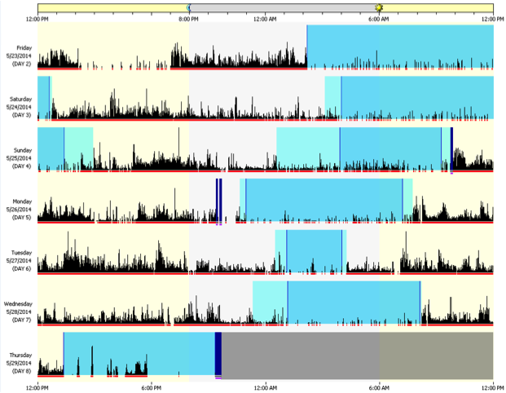
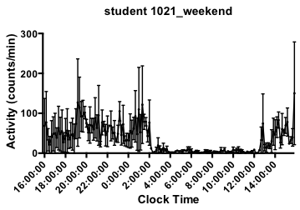
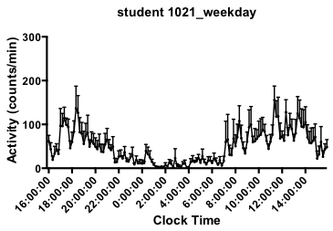
Example of individual student’s actograms
Weekend Weekday

Slide 5
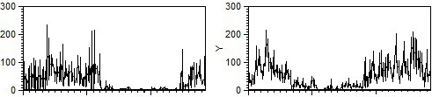
Individual student’s actograms: Incubator results match with manually-processed data
Weekend Weekday
Activity
Incubator Manual
16 20 00 4 8 12 16 16 20 00 4 8 12 16
Clock time Clock time

Slide 6
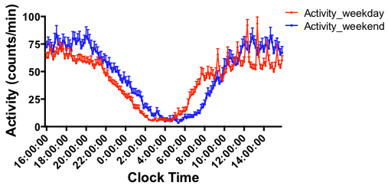
During weekend, students go to bed later,
wake up later and sleep more than during weekdays
Post-Tone
Notes:
These activity waveforms represent the average of the entire class (68 students). Some were excluded because did not wear the watch properly (off-wrist for most of the time), or when the watch broke.
Students are definitely sleeping differently between weekday and weekend.

Slide 7
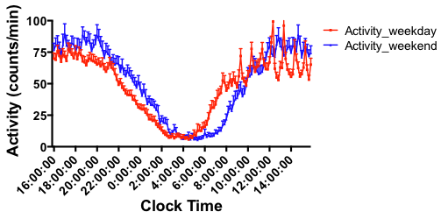
Entire class average waveforms: Incubator results match with manually-processed data
Post-Tone
Incubator Manual

Slide 8
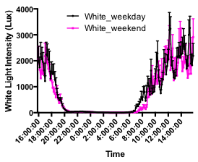
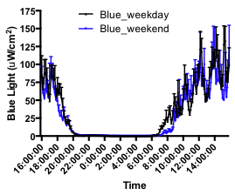
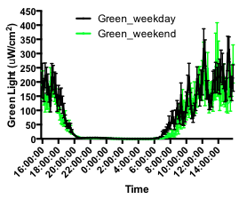
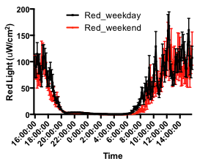
On weekend, students’ exposure to light
in the morning is delayed
Post-Tone
Notes:
When looking at 3 recorded wavelengths of light, as well as white light, student’s have different exposure when it comes to weekend.
It is surprising to me, but the onset night does not change exposure (perhaps it is the same, meaning that they go inside and have less exposure to natural light, regardless whether it is weekday or weekend). Notice that, as for activity, the onset is more gradual than the offset (probably due to individual variations). Therefore, this could explain why we do not see much difference in the onset of lights (less sensitive to capture those differences than the activity?)
What about gender? There was significant association of gender to chronotype (female tend to be earlier type than males, as predicted from the literature). However, there was not a correlation between gender and the grades (therefore, no correlation between chronotype and grades).

Slide 9
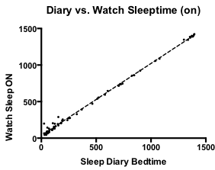
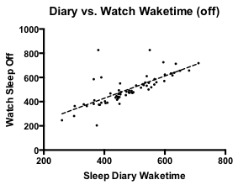
Although self-reported, diary information correlates for the most part with actiwatch data
P < 0.0001
Notes:
There are some outliers: errors in self reporting or others. But for the most part, it correlates.

Slide 10
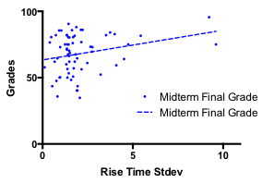
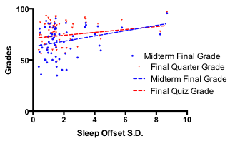
Wake time SD and Rise time SD (from Sleep Diary) correlate with grades: higher variations correlated high higher grades
Post-Tone
Wake time SD vs. Grades
Rise Time SD vs. Grades
Midterm Final Grade: P = 0.0249
Final Quarter Grade: P = 0.0490
P = 0.0396
Notes:
These results, even though seem counter intuitive, demonstrates the power of this study. Once we have bigger N, we hope to have a better idea of what is happening.
Grades: Final midterm grade, Final quiz grade, Final weekly quiz grade, Final quarter grade, GPA.
Surprisingly, I did not find a correlation between sleep onset mean or SD with grades. The only significant results were when sleep offset SD were compared with grades (and only certain types of grades), and when rise time SD (variation of the time when the students really got out of bed, not the wake up time) were compared with the Midterm Final grade. Notice this is the data from the Diary. However, notice that higher grades were correlated with higher standard deviations, which does not make sense. Some of these results do not agree with the manually processed data, which had lower stringency. Manual data analysis: positive correlation for diary onset SD, diary offset mean, diary duration with grades (the only one that makes sense is longer duration correlating with higher grades. The other ones are weird).
At the end, what we really need is more N (which we expect to get in intro bio courses or in subsequent chronobiology classes taught over the years).

Slide 11
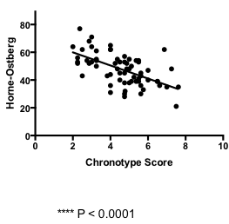
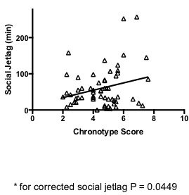
Collected data agrees with results from literature:
Late types tend to have bigger social jetlags
Chronotype questionnaires scores correlate with each other
Post-Tone
Chronotype score vs. Social Jetlag
Chronotype vs. Horne-Ostberg scores
P = 0.0449
P < 0.0001
Notes:
These results are expected:
Higher social jetlag (more difference between timing on weekdays vs. weekends), correlates with higher chronotype score (meaning, later types).
Horne-Osterg scores and chronotype scores highly correlated, since they are established as effective types of chronotype questionnaires and both have been validated by published data in the literature. Also, I do not show here, but gender was correlated to chronotype. Females had earlier chronotypes than males, which also agrees

Slide 12
Summary
Conclusions:
Most sleep parameters did not correlated with performance. Bigger N needed for definite conclusions.
Some correlations agree with literature data: later chronotypes have bigger social jetlags and females tend to be earlier types.
Students go to bed later, wake-up later and sleep more on weekends.
On Weekend, student’s exposure to light is delayed in the morning.
Post-Tone
Future directions:
Obtain bigger N.
Add demographic data (ethnic, socio-cultural, living on/off campus data etc) to correlate with sleep patterns and performance.

Slide 13



Acknowledgements
Horacio de la Iglesia (PI)
de la Iglesia lab
Gideon Dunster (manual analysis)
eScience team:
- specially Bill Howe and Dan Halperin
NSF for funding

